Slide 1
ML Production Monitoring
Pravin Y Pawar
Adapted from “Reliable Machine Learning”
By Cathy Chen

Slide 2
The basics
Monitoring, at the most basic level, provides data about how your systems are performing
data is made storable, accessible, and displayable in some reasonable way
Observability is an attribute of software, meaning that when correctly written, the emitted
monitoring data
usually extended or expanded in some way, with labeling or tagging
can be used to correctly infer behavior of system
Obviously, monitoring is hugely important in and of itself,
but an offshoot of monitoring is absolutely crucial: alerting
A useful simplification is that when things go wrong, humans are alerted to fix them
defining the conditions for “things going wrong,” and being able to reliably notify the responsible folks that

Slide 3
What Does It Look Like?
To do monitoring,
must have a monitoring system
as well as systems to be monitored (called the target systems)
Today, target systems
emit metrics a series, typically of numbers, with an identifying name
which are then collected by the monitoring system
and transformed in various ways,
often via aggregation (producing a sum or a rate across multiple instances or machines)
or decoration (adding, say, event details onto the same data)
aggregated metrics are used for system analysis, debugging, and the alerting

Slide 4
Example
Web Server
Web server emits a metric of the total number of requests it received
The monitoring system will obtain these metrics, usually via push or pull,
which refers to whether the metrics get pulled from the target systems or get pushed from them
These metrics are then collated, stored,
and perhaps processed in some way, generally as a time series
Different monitoring systems will make different choices about how to receive, store, process,
but the data is generally queryable and often there’s a graphical way to plot the monitoring data
to take advantage of our visual comparison hardware (eyes, retinas, optic nerves, and so on) to figure
out what’s actually happening

Slide 5
Problems with ML Production Monitoring
ML model development is still in its infancy!
tools are immature, conceptual frameworks are underdeveloped
discipline is in short supply, as everyone scrambles to get some kind of model—any kind of model!
The pressure to ship is real and has real effects!
In particular, model development,
which is inherently hard because it involves reconciling a wide array of conflicting concerns
gets harder because that urgency forces developers and data science folks to focus on those hard problems
ignore the wider picture
That wider picture often involves questions around monitoring and observability!

Slide 6
Difficulties of Development Versus Serving
The first problem is that effectively simulating production in development is extremely hard
Even if separate environments dedicated to that task (like test, staging, and so on.)
Primarily Because of
the wide variety of possible serving architectures
model pools, shared libraries, edge devices, etc., with the associated infrastructure running on)
the invocation of the predictions
in development often invoke prediction methods directly or with a relatively small amount of code between developer and the model for velocity reasons
Running in production also generally means don’t have the ability to manipulate input, logging level, processing, and so on
leading to huge difficulties in debugging, reproducing problematic configurations, etc.
data in testing is not necessarily distributed like the data the model encounters in production
as always for ML, data distribution really matters

Slide 7
Difficulties of Development Versus Serving(2)
The second problem is about mature practices
In conventional software delivery,
the industry has a good handle on work practices to improve throughput, reliability, and developmental velocity
most important is grouped concepts of continuous integration / continuous deployment (CI/CD), unit tests, small changes
Unfortunately, today w\missing this equivalent of CI/CD for model development
not yet converged onto a good set of (telemetry-related, or otherwise) tools for model training and validation
Expect this will improve over time as
existing tools (such as MLflow and Kubeflow) gain traction
vendors incorporate more of these concerns into their platforms
and the mindset of holistic, or whole-lifecycle monitoring gains more acceptance

Slide 8
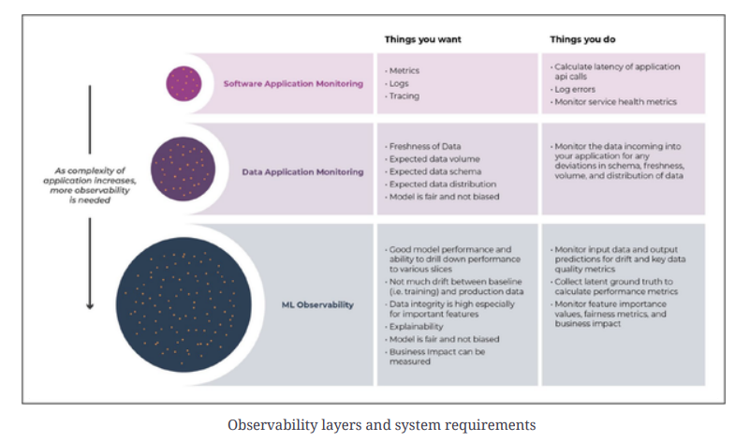
Observability layers and system requirements

Slide 9
Reasons for Continual ML Observability—in Production
Observability data from models is absolutely fundamental to business
both tactical operations and strategic insights
One example - connection between latency and online sales
In 2008, Amazon discovered that each additional 100 ms of latency lost 1% of sales,and also the converse
Similar results have been confirmed by Akamai Technologies, Google, Zalando, and others
Without observability, there would be no way to have discovered this effect,
and certainly no way to know for sure that either making it better or worse!
Ultimately, observability data is business outcome data
In the era of ML, this happily allows not just to detect and respond to outages,
but also to understand incredibly important things that are happening to business

Slide 10
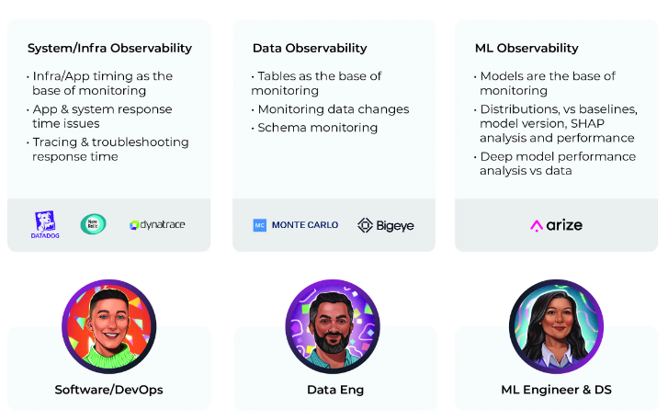
ML observability in context
arize

Slide 11
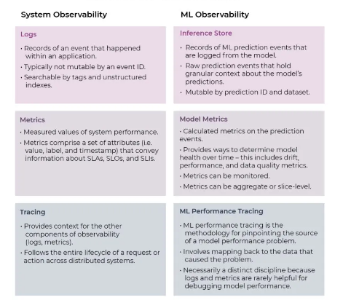
Key Components of Observability
System vs Machine Learning

Slide 12
Thank You!
In our next session:

